Slide 1
Identifier in the IOT
The importance of 'Identifiers' in the Internet of Things
Dr. Vinayak Ashok Bharadi

Slide 2
The Internet of Things (IoT) is about interaction between things and users of the things by electronic means, such as sensors, actuators and wireless communication.
For example, IoT easily allows the automatic control of temperature and lighting in a house or an office based on people's needs and environmental conditions.
However, users of a thing can be humans, software applications or even other things. In order to establish this interaction, it is important to clearly identify the things and the users.

Slide 3
Identifier
It is a pattern to uniquely identify a single entity or a class of entities within a specific context. That can be inherent patterns of the thing itself like finger prints and facial structures or patterns added by technical means like printed serial numbers, bar codes or Radio Frequency Identification (RFIDs) tags.
Within IoT Systems identifiers are used for different purposes that go beyond just the identification of things and users.
For the design, but also for the use of IoT solutions, it is important to know the various usages of identifiers, the related requirements, interoperability, security and privacy issues and which standards are available for them.

Slide 4
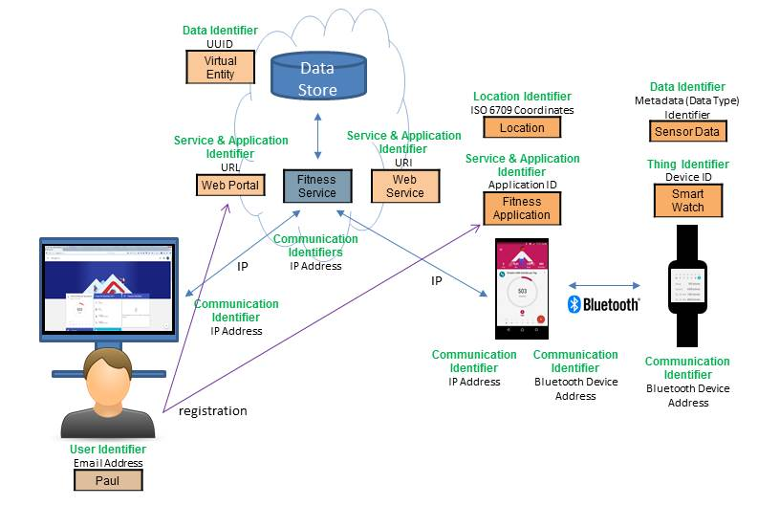

Slide 5
Due to the above mentioned diversity of identifier and use cases the Alliance for Internet of Things Innovation (AIOTI) working group on IoT Standardization (WG03) decided a year ago to perform a thorough analysis of identification needs in IoT and related standardization.

Slide 6
IoT identifiers – what are we naming?
Physical device
Changes if new board or repair replacement
MAC address
Logical device
may move, but same owner until sold
”the heart rate monitor worn by X”
cf. mobile phone number
Functional device
identified by logical function
location, service, …

Slide 7
IoT identifiers - requirements
Clear semantics
invariants (location? device hardware? owner? role?)
suitable for program logic
one or ”anycast”?
Securable
entity needs to be able to prove its identity (via X.509 cert)
get certificates for identifiers
automated assignment (see IETF ACME protocol)
Clear reachability
local network only or from anywhere on the Internet?
Low-infrastructure
federated; avoid single global directory
enable local queries without server setup (multicast query)
Simplicity
low conceptual overhead for programmers (e.g., not become an RDF or SPARQL expert)

Slide 8
IoT identifiers
Today, IP address and domain name
Both have unclear semantics
may change unpredictably (DHCP, multiple network interfaces, mobility)
unclear if auto-generated (dhcp137.cs.columbia.edu) or static (printer-cepsr6.cs.columbia.edu)
could refer to multiple A or AAAA records
Domain names not practical for most consumer applications (mostly)
annual cost and renewal risk
dynamic updates of IP address mappings
might be feasible as managed service
except as sub-domain of provider (4fb647a36a.iot-r-us.com)
maybe local domain (node.home.arpa) – see draft-ietf-homenet-simple-naming
Notes:
https://tools.ietf.org/html/draft-ietf-homenet-simple-naming-02

Slide 9
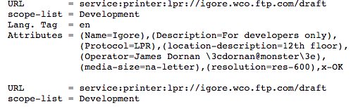
Identifier vs. service location
SRV records - A Service record (SRV record) - a specification of data in the Domain Name System defining the location, i.e., the hostname and port number, of servers for specified services. It is defined in RFC 2782, and its type code is 33.
SLP identifier (RFC 2608, June 1999) - Service and Logistics Portal
Ontology queries (RDF + SPARQL)
semantic web: https://www.w3.org/standards/semanticweb/
“node that provides temperature readings in Bergen County, NJ, USA”
Typically requires sophisticated ontology knowledge
but maybe simplified interfaces?
location, authorization, type of data?

Slide 10
How should we name things?
network interface
device
(independent of network)
device by function & location
EUI-64
domain name? → portability?
phone number?
“ceiling lamp in kitchen”
(used in programs)
IPv6

Slide 11
Communication identifiers
Property | URL owned | URL provider | E.164 | Service-specific
Example | alice@smith.name sip:alice@smith.name | alice@gmail.com sip:alice@ilec.com | +1 202 555 1010 | www.facebook.com/alice.example
Protocol-independent | no | no | yes | yes
Multimedia | yes | yes | maybe (VRS) | maybe
Portable | yes | no | somewhat | no
Groups | yes | yes | bridge number | not generally
Trademark issues | yes | unlikely | unlikely | possible
Privacy | Depends on name chosen (pseudonym) | Depends on naming scheme | mostly | Depends on provider “real name” policy
→ IoT will likely be assigned local IP address space and owner-based names (meter17.pseg.com) [if any]
Notes:
http://findmyfacebookid.com

Slide 12
References
https://wiki.dbpedia.org/apply
An Internet of Things Platform for Real-World and Digital Objects (https://www.scpe.org/index.php/scpe/issue/view/99)
OpenIoT: W3C Semantic Sensor Networks (SSN)
https://link.springer.com/chapter/10.1007/978-3-319-16546-2_3

